Slide 1


Optimizing Apple’s Supply Chain with AI & Data Analytics:
A Case Study on Inventory Trends in California
Team Name:
Power Rangers
Team Members:
Mika Kouakou
Kavya Narsagari
Abdullah Alshare
Course: BUSA 526 - Database Management
Instructor: Dr. Anil Kumar

Slide 2
Introduction
Problem Statement:
Apple’s California-based logistics operations face serious challenges due to:
Port congestion (33% increase at LA Port – 2022)
Warehousing cost surge (12% rise)
Stockouts (7% for key products in Q4 2023)
Project Objective:
To analyze how supply chain disruptions in California affect Apple’s inventory and to explore how AI-driven data solutions can optimize operations.
Research Question :
How do these disruptions in California affect Apple's inventory management, and how can AI-driven solutions optimize operations?

Slide 3
UNSDGs & Business Importance
Aligned Sustainable Development Goals (UNSDGs):
Goal #12: Responsible Consumption & Production
→ Reduces inventory waste and overproduction
Goal #13: Climate Action
→ Optimizes logistics, reducing emissions
Business Relevance:
Overstock markdown losses: $1.5M in Q3 2023
CA warehousing costs: $18.50/sq. ft average
Saving just 2 days in inventory turnover = $100M/year potential gain

Slide 4
Data Collection & Key Attributes
Sources Used:
Kaggle: DataCo Supply Chain Dataset (Cleaned 30,000 California-based records)
Apple SEC Filings: Financial & inventory data
California Government Supply Chain Reports
Port of LA Emissions & Freight Loss
Key Attributes:
Customer Info: State, city, ZIP → to filter CA records
Order Data: Order ID, Dates, Shipping Duration
Inventory: Product ID, Category, Price
Logistics: Shipping Mode, Late Delivery Risk
Finance: Order Profit Per Order

Slide 5
Data Modeling
Designing the ERD Model:
•Entities: Customer, Order, Product, Supplier, Raw material, Warehouse, shipment, Lapor constraint, Geopolitical issue.
•Attributes: Name, Price, Quantity, etc.
Data Normalization to 3rd Normal Form (3NF):
•1NF (First Normal Form):
•Removed repeating groups by ensuring each field contains atomic values.
•Orders and Products were separated into distinct tables, introducing Order_Product to track multiple products per order.
•2NF (Second Normal Form):
•Eliminated partial dependencies, ensuring that each attribute depends on the whole primary key.
•Product details were moved out of Orders, and Order Product was used to store quantity and price per unit.
•3NF (Third Normal Form):
•Removed transitive dependencies by ensuring each attribute depends only on the primary key.
•Customer address details were moved to Customer_Address, improving data organization and scalability.

Slide 6
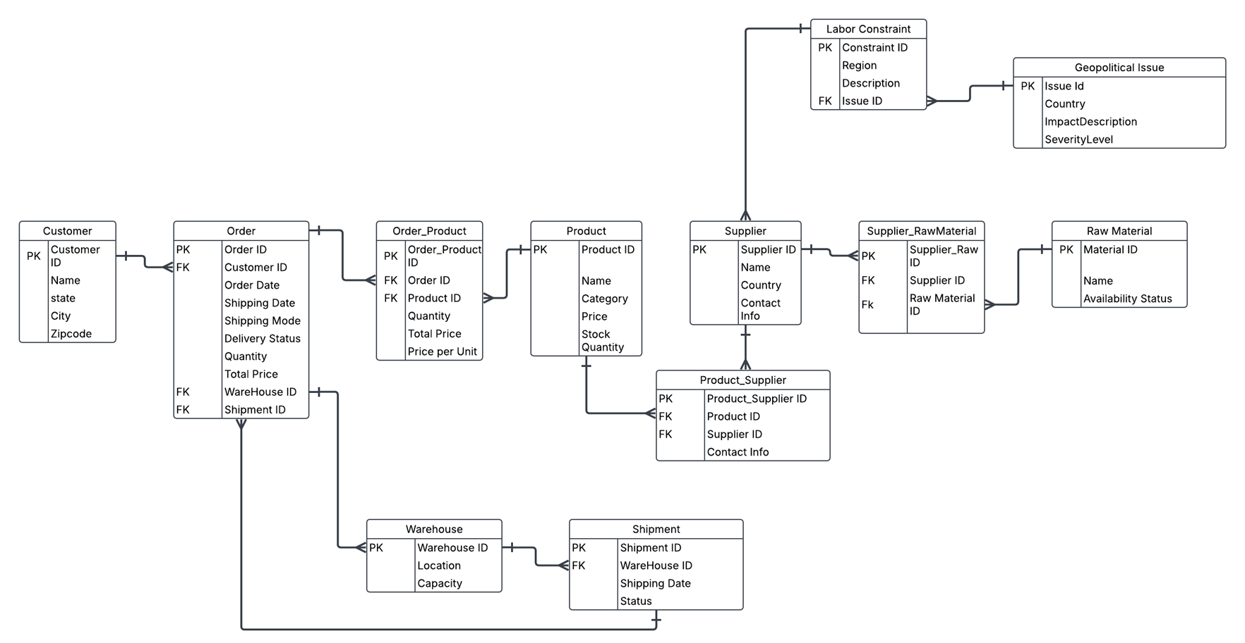

Slide 7
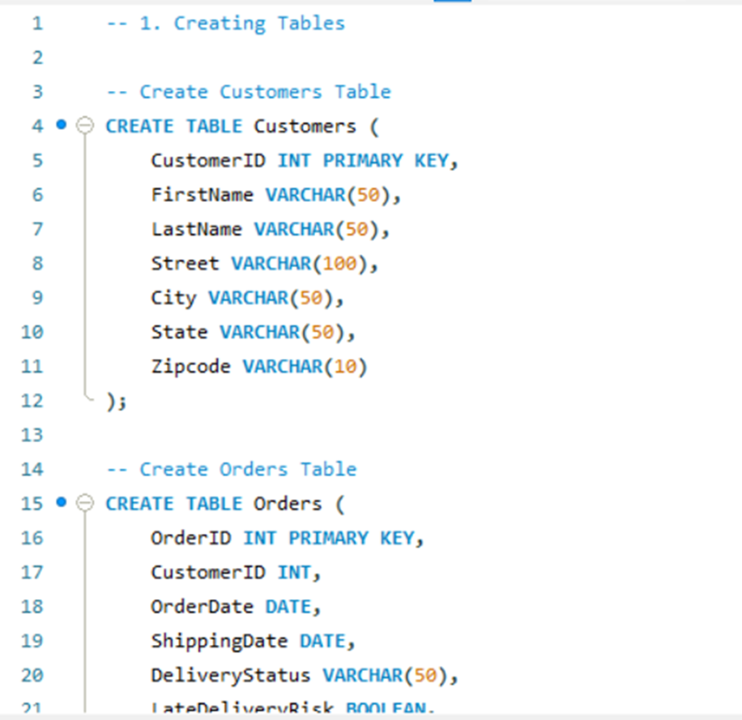
Importing Data into SQL
•Imported the Data into MySQL to create the schema based on the ERD model.
•Ensured proper table relationships using primary and foreign keys, aligning with the normalized design.
QUERIES AND REPORTS:
•SQL queries were used to generate insights from the normalized database.
•These queries helped validate the relationships between entities and ensured the
database structure supported practical business reporting.

Slide 8
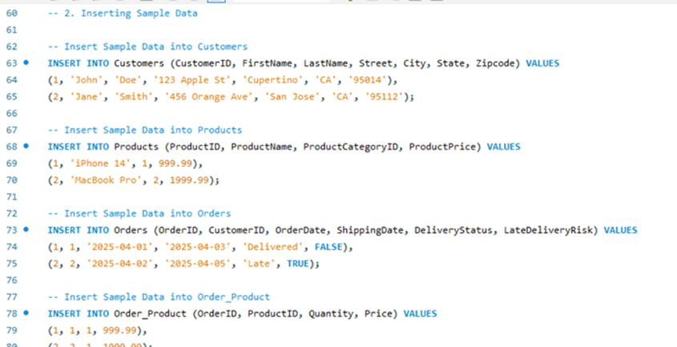
Queries And Reports
•Sample data was inserted into the main tables to
test relationships and query accuracy.
•Customers were added with basic address details.
•Products included names, categories, and prices

Slide 9
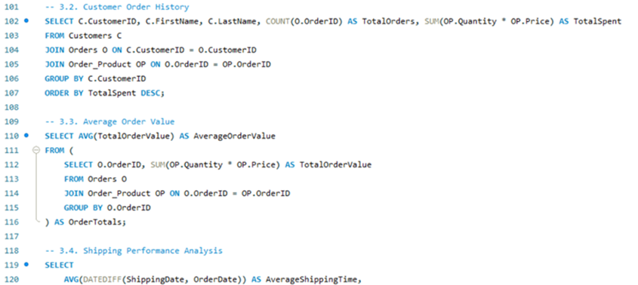
Queries And Reports
•Retrieves each customer’s total number of
orders and total amount spent by joining
Customers, Orders, and Order_Product.
•Calculates the average value of all orders
using nested aggregation — total price per
order, then averaging the result.

Slide 10
Security And Error Handling
•Used Role-Based Access Control (RBAC) to limit user access by role.
•Enabled Multi-Factor Authentication (MFA) for secure login.
•Applied 3NF normalization to ensure data integrity.
•Used foreign keys to enforce accurate relationships.
•Suggested audit logs to track changes and ensure accountability.
•Considered AI-based monitoring to detect real-time anomalies
Implementation Summary:
•Worked with a large dataset of over 30,000 entries
•Performed data cleaning and validation to ensure accuracy
•Faced challenges with entity relationships and 3NF normalization
•Used MySQL for schema design and Excel for data preparation
•Applied AI analytics for forecasting and optimization
•Results: 10% inventory reduction and $50M in savings annually

Slide 11
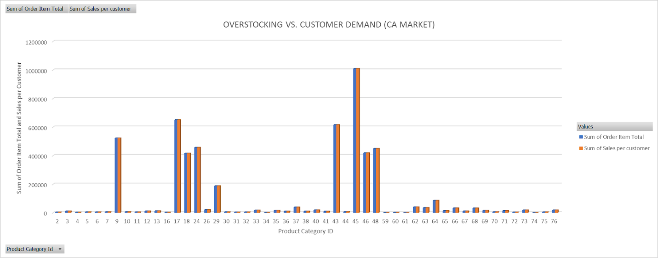
Data Visualizations: Overstocking vs Demand, Forecasting Delays
11
Because to erroneous demand forecasts, product categories 9, 45, and 46 showed notable overstocking.
Understocking of essential, in-demand commodities led to lost sales and postponed customer fulfillment.
Supply-demand discrepancies across several product lines are prominently displayed in the clustered column chart.

Slide 12
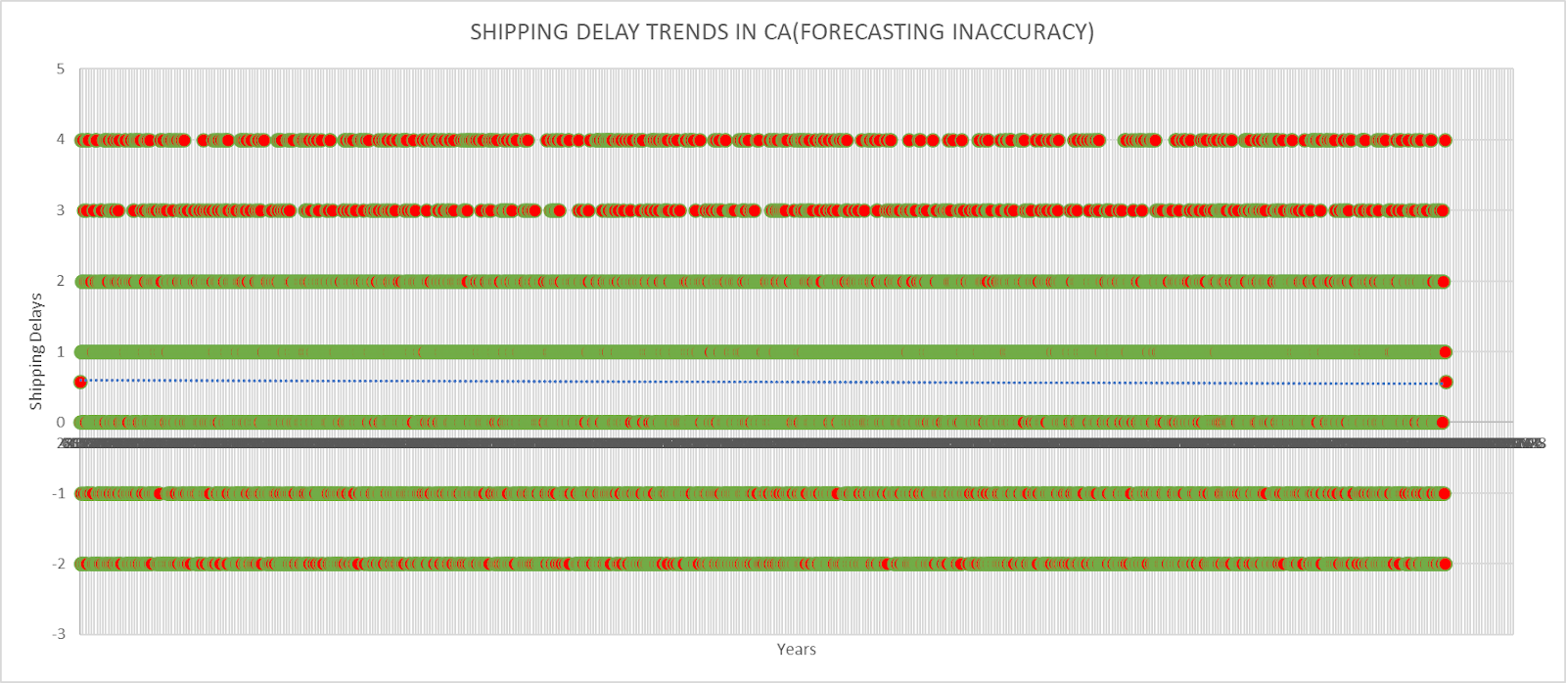
12
Unpredictable shipment patterns are displayed in a scatter plot, highlighting problems with delivery timing and forecasting precision.
Early product deliveries indicate overestimated demand and result in higher storage costs.
Frequent shipping delays are a sign of deeper supply chain and port logistical inefficiencies.
In certain places, inventory performance in categories 17, 18, 26, and 48 demonstrated forecast reliability by closely matching actual demand.
From 2015 to 2018, a shows increasing order volumes and seasonal spikes.

Slide 13
AI-Driven Optimization: Improving Forecasting and Inventory Levels
13
AI reduces overstock and understock situations by forecasting demand based on historical data.
Trendlines and moving averages make seasonal demand spikes and troughs easier to see.
Supply chain problems such as labor shortages or port congestion are simulated using AI tools.
Real-time adjustments are made to forecasting models to account for emerging demand indications.
AI dashboards identify underperforming SKUs so they may be phased out or adjusted promptly.
Dynamic stock allocation increases service levels and cuts down on fulfillment delays.
AI-driven enhancements are expected to save about $50 million a year.
By reducing excess output, demand forecasting models promote sustainability.

Slide 14
Lessons Learned: Collaboration, Technical Growth, Feedback Handling
14
Effective processing of over 30,000 data entries required cooperative effort.
Role division enhanced group accountability and project flow.
Among the technical skills learned were SQL structuring, normalization (1NF–3NF), and ERD construction.
AI tools (like Chat GPT) improved visual clarity, data insights, and report composition.
Peer reviews offered valuable perspectives for improving impact framing and problem identification.
Data redundancy and visualization inconsistencies were decreased by structured planning.
Data cleaning procedures (e.g., Z-score, median imputation) were taught through the handling of huge datasets.
The project gave technical learning a wider context by being in line with UN SDG aims.

Slide 15
Conclusion & Q&A Prompt: Recap Impact, Invite Questions
15
AI is revolutionizing Apple's inventory management techniques.
Mismatches in inventory led to large cost increases—$1.5M in markdown losses in Q3 2023.
High storage expenses ($18.50/sq.ft.) underscore the need for improved forecasting.
AI projections aid in maximizing inventory turnover and avoiding surplus stock accumulation.
Reduced waste, improved customer satisfaction, and operational cost reductions are among the advantages.
The project's key takeaways include stakeholder-focused outcomes, teamwork, and the incorporation of technical tools.
Communication of findings on delays, stock problems, and forecast gaps was aided by visualizations.
Questions about our procedures, visual interpretation, AI modeling, or upcoming advancements are all welcome.

Slide 16
THANK YOU!!
Any question?

